Slide 1
The Battle of Neighborhoods Applied Data Science Capstone Project
How do I find a good neighbourhood in the greater Dallas county to start my Asian restaurant?
Elizabeth Nguyen

Slide 2
Introduction
Background
Asian migrants to the U.S. tends to favor starting a Asian cuisine as a viable option when starting a new life there.
Problem Description
U.S. is a big place and finding a feasible location to start an Asian cuisine can be a challenge.
This project demonstrates how the basic fundamental law of Demand and Supply can be used to analyze statistical data
This project will use the greater area of Dallas and narrow down to a few feasible neighborhoods. The same process can be repeated with other areas of interest.
Interest
Those who are interested in starting an Asian Restaurant in the U.S. once they migrate there.

Slide 3
Data Acquisition and Processing
Data Terminology
Term “Asian cuisine” has loose definition and its interpretation can impact the nature of data from a given source
Data Sources: 3 types identified
Demographic profile from U.S. Census Bureau 2013-2017 American Community Survey 5-Year Estimates (ACS) and Center for Public Policy Priorities
Venue data from Foursquare.com
Dallas zip codes for the neighborhoods in Dallas county and the latitude/longitudes
Data cleaning
Foursquare takes a lat/long, a radius, and attempts to retrieve the specified number of venues covered by the circle scribed by the radius. Small radius means insufficient venues retrieved. Large radius means overlapping circles and duplicate venues
Food Venue Category- venues are classified rather arbitrary
Census data is only a rough guide, sourced from ACS is up to 2017.

Slide 4
Data Acquisition and Processing (cont.)
Feature selection
Dallas county has 20 neighborhoods and 84 zip codes. Group by neighborhoods
Foursquare will retrieve firstly by food, then by Asian food
Demographics- % of Asian population
Analytical method – Demand and Supply of the market segment
The data is influenced by the understanding of of the definition of food category, such as “Asian” vs “Sushi” or “dumpling”
Percentage of Asians population in a neighborhood may be related to amount of Asian venues in that neighborhood

Slide 5
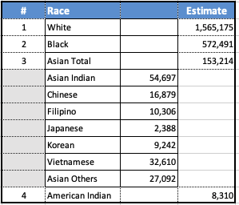
Exploratory Data Analysis - Demographics
The population of Dallas county is approximately 2.4M, with:
White being 1.56M which is 61% and
Asians forming 153K which translates to 6%
The table shows a snippet of the census data from ACS which shows the breakdown of what constitutes Asian where Vietnamese forms 21% of the Asian race. Chinese forms only 11%. Asian Indian form 36%
Hence, any neighbourhood with higher than 6% Asian population is worth noting.

Slide 6
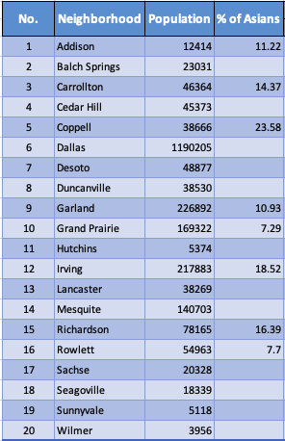
Exploratory Data Analysis – Demographics (cont.)
Also, most of the neighbourhood with higher percentage of Asian population such as, Addison, Coppell, Garland, Sachse, Richardson, and Rowlett are all to the North side (between North East to North West) of Dallas
Another thing to call out will be that Richardson is the home to University of Texas, Dallas. The university has reported that 29.5% of its undergrads are Asians
University of Texas, Dallas, Undergraduate Ethnic Diversity

Slide 7
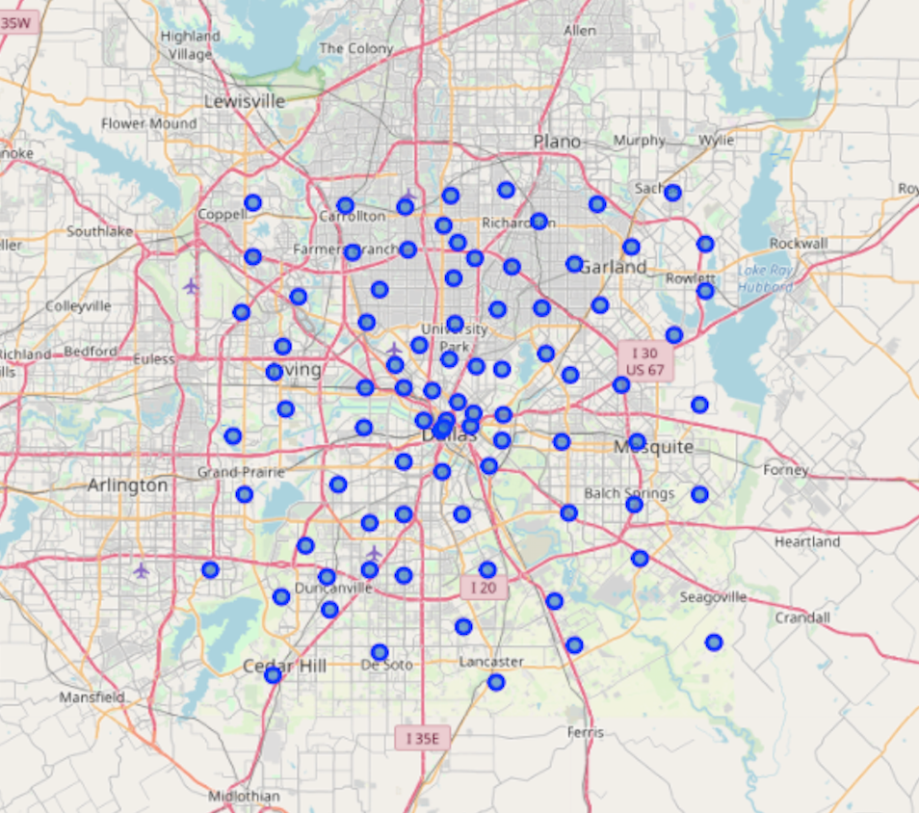
Exploratory Data Analysis –Foursquare
Foursquare takes a lat/long, a radius, and attempts to retrieve the specified number of venues covered by the circle scribed by the radius.
Folium map shows zip code density higher around Dallas central
The returned values were grouped by neighbourhood as there would otherwise be 84 zip codes as opposed to 20 neighborhoods
3KM radius passed to Foursquare may not be effective if venue density is too high resulting in overlapping zip codes or too low with less values returned.

Slide 8
Exploratory Data Analysis –Foursquare (cont.)
The All venues frequency is built using the “Food” as venue category
The Asian venues frequency is built using the “Asian Restaurant” as venue category
The returned values were grouped by neighbourhood as there would otherwise be 84 zip codes as opposed to 20 neighborhoods.
Foursquare venue data shows that places with percentage of Asian population above the 6% average also tend to have a higher ratio of Asian venues.
Richardson which has 67% Asian venues is the home of the University of Texas, Dallas.
No | Neighborhood | Population | % of Asians | Venues Frequency
 |  |  |  | All | Asian
1 | Addison | 12414 | 11.22 | 100 | 38
2 | Balch Springs | 23031 |  | 40 | 5
3 | Carrollton | 46364 | 14.37 | 100 | 65
4 | Cedar Hill | 45373 |  | 50 | 3
5 | Coppell | 38666 | 23.58 | 75 | 9
6 | Dallas | 1190205 |  | 3506 | 1235
7 | Desoto | 48877 |  | 40 | 3
8 | Duncanville | 38530 |  | 117 | 20
9 | Garland | 226892 | 10.93 | 321 | 70
10 | Grand Prairie | 169322 | 7.29 | 136 | 15
11 | Hutchins | 5374 |  | 10 | 2
12 | Irving | 217883 | 18.52 | 481 | 98
13 | Lancaster | 38269 |  | 30 | 3
14 | Mesquite | 140703 |  | 187 | 16
15 | Richardson | 78165 | 16.39 | 200 | 134
16 | Rowlett | 54963 | 7.7 | 79 | 15
17 | Sachse | 20328 |  | 17 | 4
18 | Seagoville | 18339
19 | Sunnyvale | 5118 |  | 7 | 1
20 | Wilmer | 3956 |  | 7

Slide 9
All Venues Frequencies in Dallas County from Foursquare
Foursquare breakdowns the Asian venue into its subclassifications such as Chinese, Asian, Thai, Indian, Japanese, and Korean.
Data is just indicative - Coppell has a 23.58 % Asian population, but no Asian or Chinese venues in top 20. Has Indian, Japanese & Vietnamese venues.

Slide 10
Asian Venues Frequencies in Dallas County from Foursquare
“Asian” and “Chinese” restaurant classification may be a bucket for those that restaurants that offer a ”wider” variety of cuisines
Neighborhoods that have Chinese and/or Asian restaurants below top 4 ranking, which is Desoto, Hutchins, Grand Prairie, Sachse, and Sunnyvale, all have a below average % of Asian populations

Slide 11
Interpreting the results
Terminologies and classifications don’t follow a hard and fast rule. Need to use judgement when analyzing results from Foursquare or Census ACS.
Generally, neighborhoods with above average Asian population have an average higher ratio of Asian venue count.
Data may be skewed either by zoning, such as the city of Dallas which has multiple zip codes or neighborhoods with high concentration such as universities
The trend is for a restaurant to serve a wide range of Asian cuisines and classify itself Asian or Chinese restaurant.
Hence, in conclusion, places with high concentration of Asians such as universities or neighborhoods with above average percentage of Asian population is worth exploring for starting an Asian restaurant that offers a wide option of Asian cuisine

